Slide 1
More About Objects and Methods
Chapter 6

Slide 2
Objectives
Define and use constructors
Write and use static variables and methods
Use methods from class Math
Use predefined wrapper classes
Use stubs, drivers to test classes and programs

Slide 3
Objectives
Write and use overloaded methods
Define and use enumeration methods
Define and use packages and import statements
Add buttons and images to JavaFX applications

Slide 4
Constructors: Outline
Defining Constructors
Calling Methods from Constructors
Calling a Constructor from Other Constructors

Slide 5
Defining Constructors
A special method called when instance of an object created with new
Create objects
Initialize values of instance variables
Can have parameters
To specify initial values if desired
May have multiple definitions
Each with different numbers or types of parameters

Slide 6
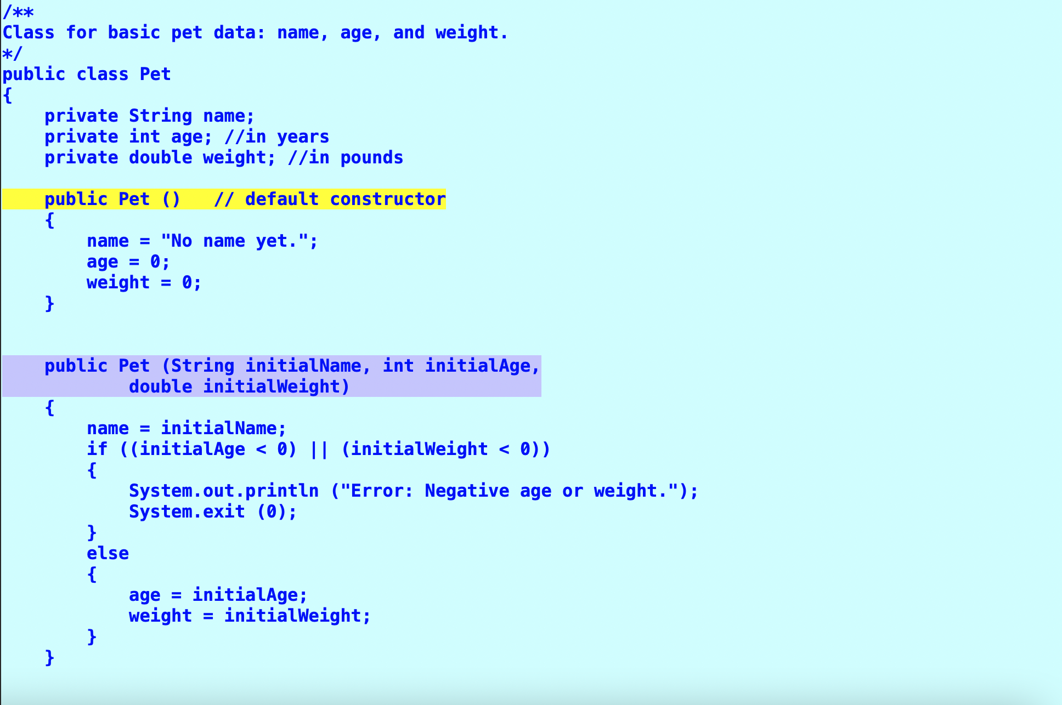

Slide 7
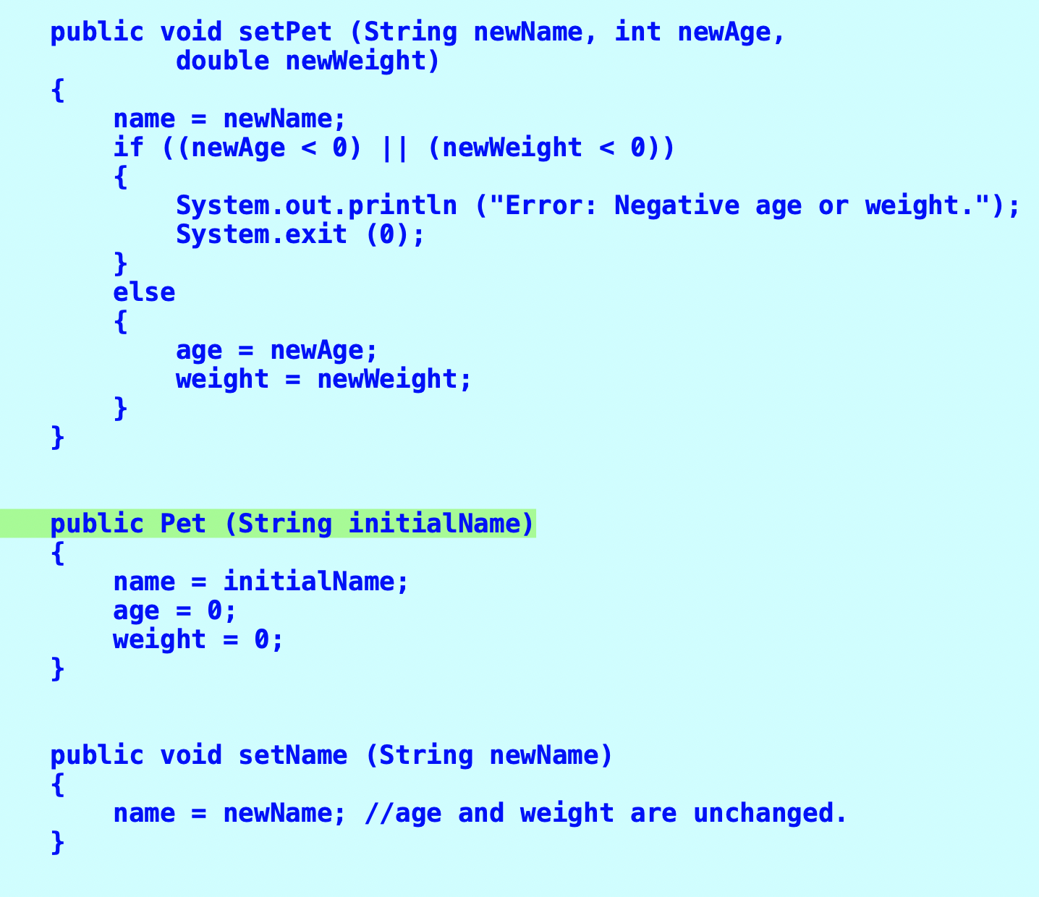

Slide 8
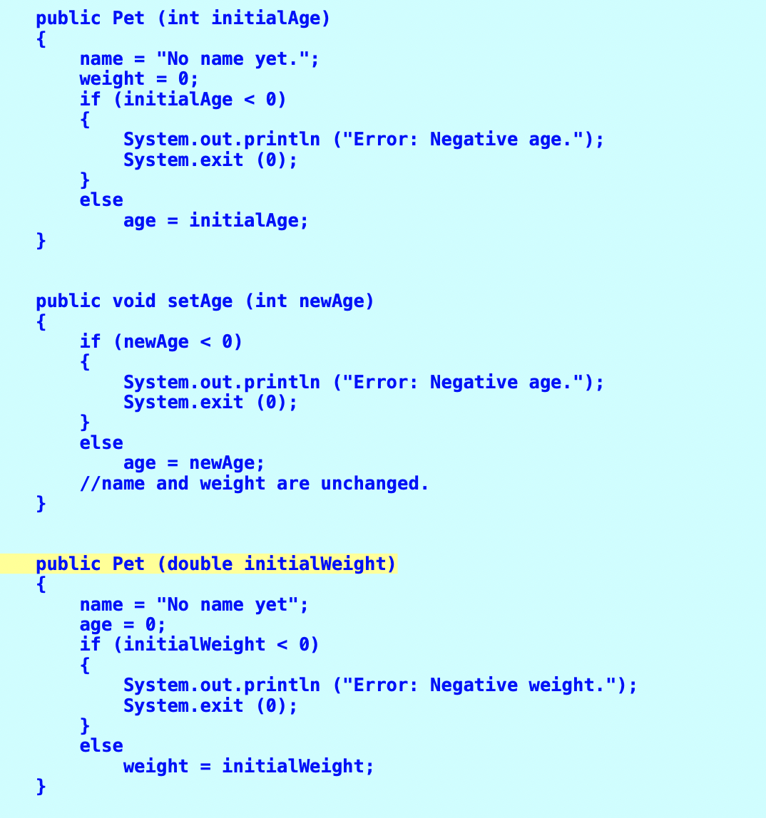

Slide 9
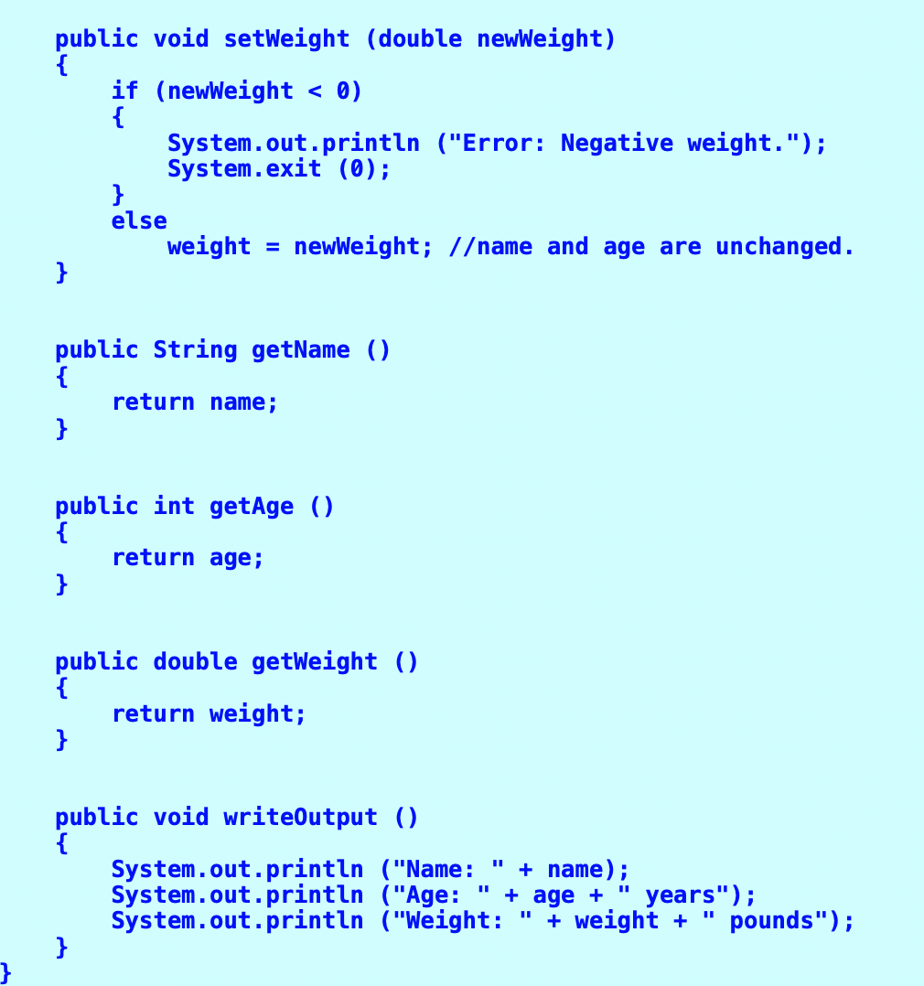

Slide 10
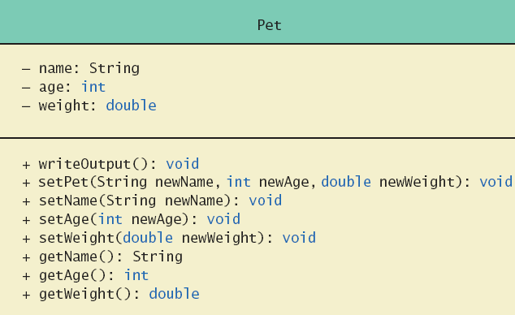
Defining Constructors
Example class to represent pets
Figure 6.1 Class Diagram for Class Pet

Slide 11
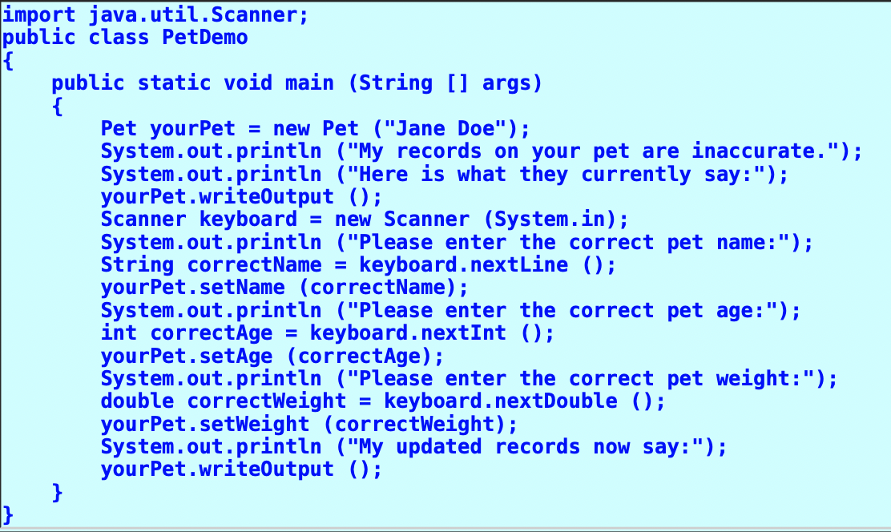
TESTING THE PET CLASS

Slide 12
Defining Constructors
Note sample code, listing 6.1 class Pet
Note different constructors
Default
With 3 parameters
With String parameter
With double parameter
Note sample program, listing 6.2 class PetDemo

Slide 13
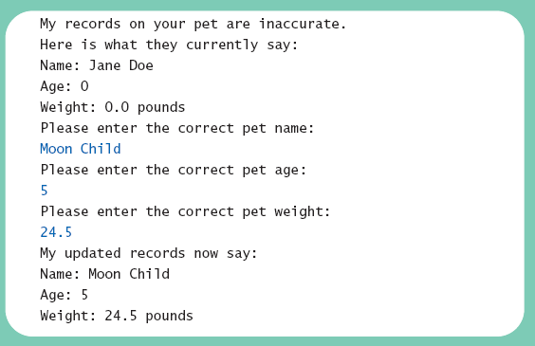
Defining Constructors
Sample screen output

Slide 14
Defining Constructors
Constructor without parameters is the default constructor
Java will define this automatically if the class designer does not define any constructors
If you do define a constructor, Java will not automatically define a default constructor
Usually default constructors not included in class diagram

Slide 15
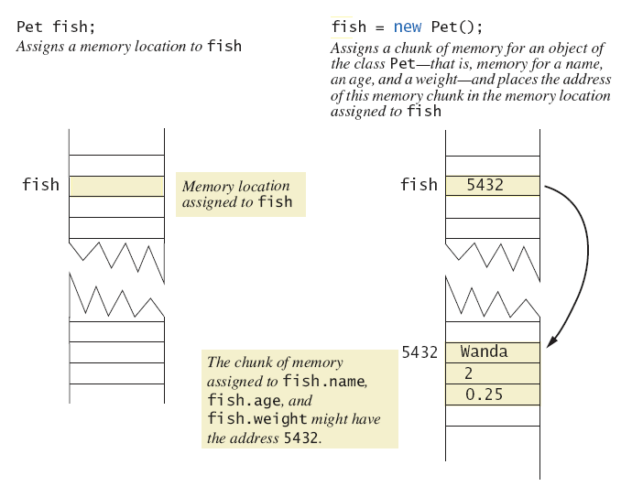
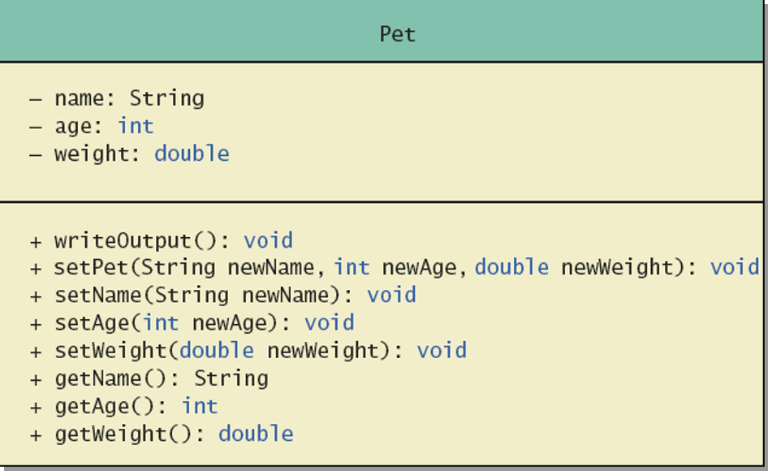
Defining Constructors
Figure 6.2 A constructor returning a reference

Slide 16
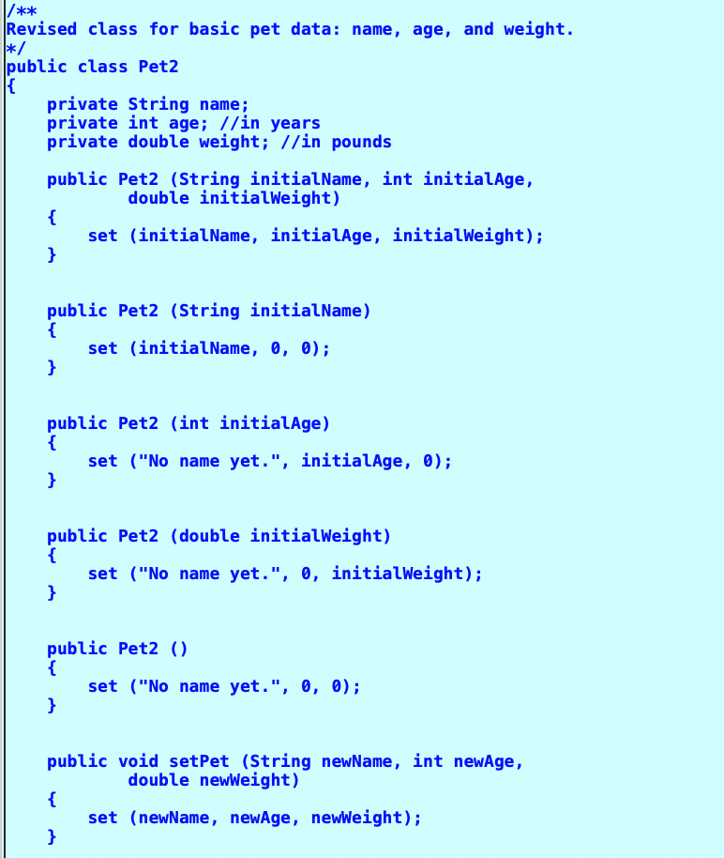
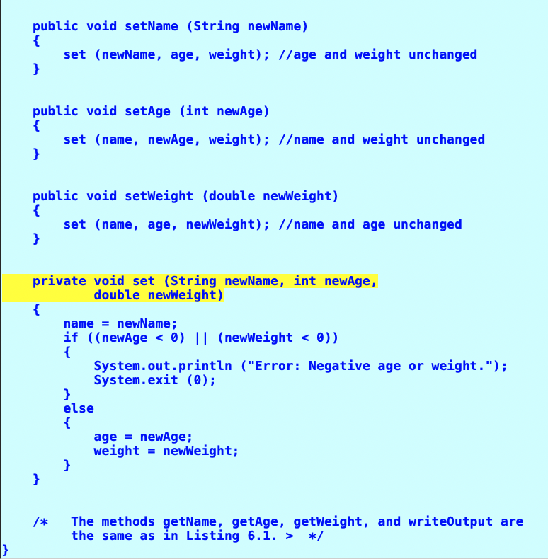
ANOTHER EXAMPLE

Slide 17
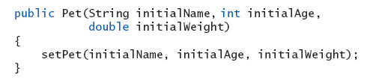
Calling Methods from Other Constructors
Constructor can call other class methods
View sample code, listing 6.3 class Pet2
Note method set
Keeps from repeating code

Slide 18
Calling Constructor from Other Constructors
From listing 6.3 we have the initial constructor and method set
In the other constructors use the this reference to call initial constructor
View revised class, listing 6.4 class Pet3
Note calls to initial constructor

Slide 19
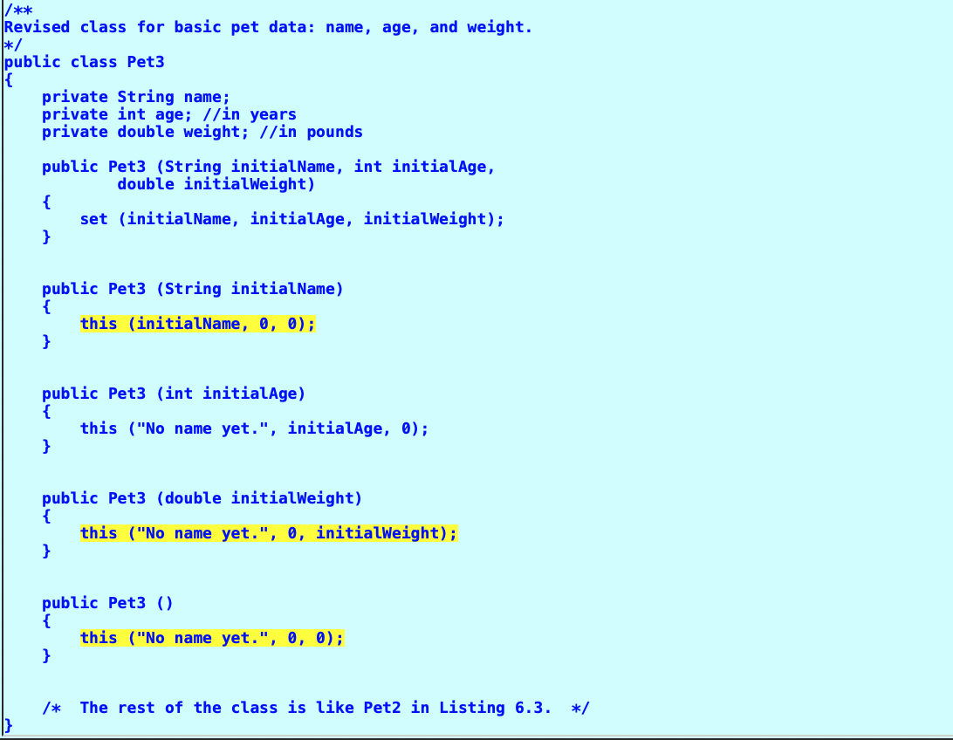
Calling Constructor from Other Constructors

Slide 20
Static Variables & Methods: Outline
Static Variables
Static Methods
Dividing the Task of a main Method into Subtasks
Adding a main Method to a class
The Math Class
Wrapper Classes

Slide 21
Static Variables
Static variables are shared by all objects of a class
Variables declared static final are considered constants – value cannot be changed
Variables declared static (without final) can be changed
Only one instance of the variable exists
It can be accessed by all instances of the class

Slide 22
Static Variables
Static variables also called class variables
Contrast with instance variables
Do not confuse class variables with variables of a class type
Both static variables and instance variables are sometimes called fields or data members

Slide 23
Static Methods
Some methods may have no relation to any type of object
Example
Compute max of two integers
Convert character from upper- to lower case
Static method declared in a class
Can be invoked without using an object
Instead use the class name

Slide 24
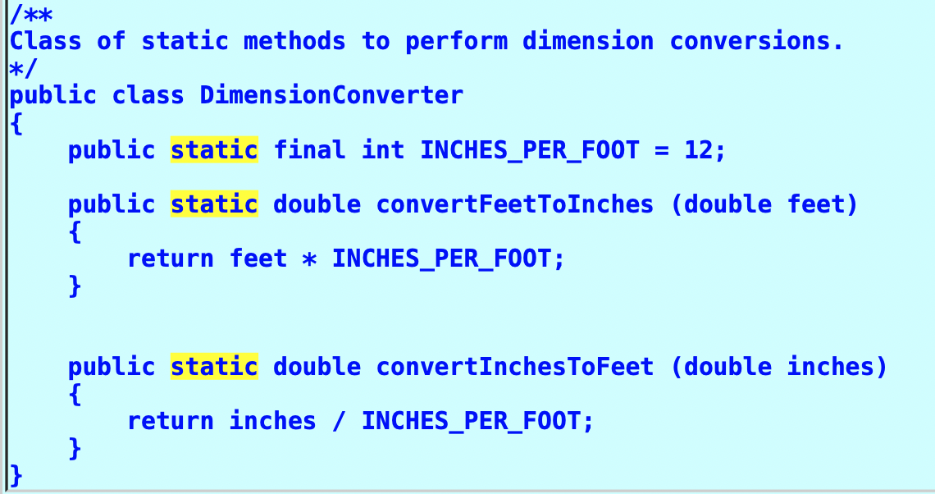

Slide 25
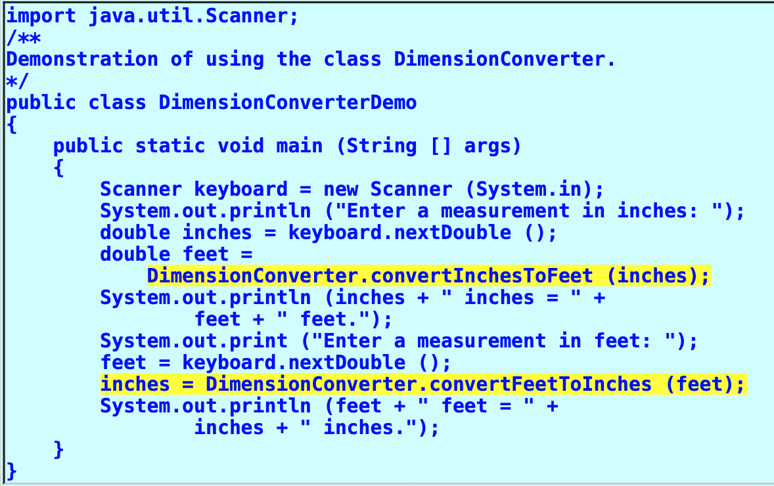

Slide 26
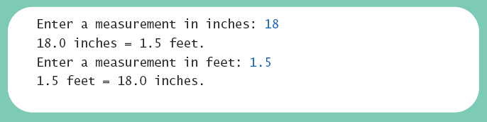
Static Methods
View sample class, listing 6.5 class DimensionConverter
View demonstration program, listing 6.6 class DimensionConverterDemo
Sample screen output

Slide 27
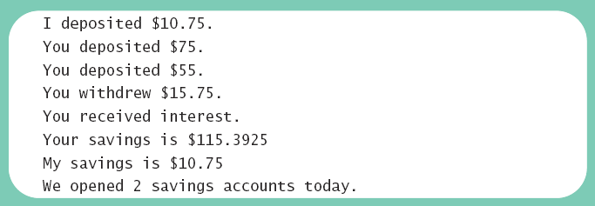
Mixing Static and Nonstatic Methods
View sample class, listing 6.7 class SavingsAccount
View demo program, listing 6.8 class SavingsAccountDemo
Sample screen output

Slide 28
Adding main Method to a class

Slide 29
Tasks of main in Subtasks
Program may have
Complicated logic
Repetitive code
Create static methods to accomplish subtasks
Consider example code, listing 6.9 a main method with repetitive code
Note alternative code, listing 6.10 uses helping methods

Slide 30
Adding Method main to a Class
Method main used so far in its own class within a separate file
Often useful to include method main within class definition
To create objects in other classes
To be run as a program
Note example code, listing 6.11 a redefined class Species
When used as ordinary class, method main ignored

Slide 31
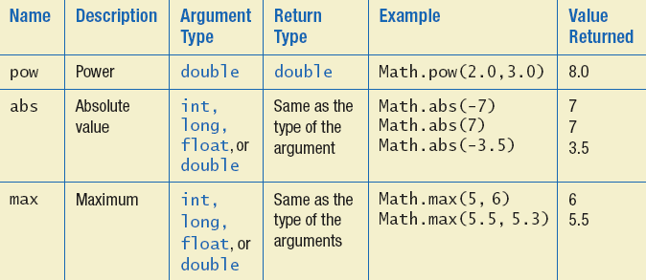
The Math Class
Provides many standard mathematical methods
Automatically provided, no import needed
Example methods, figure 6.3a

Slide 32
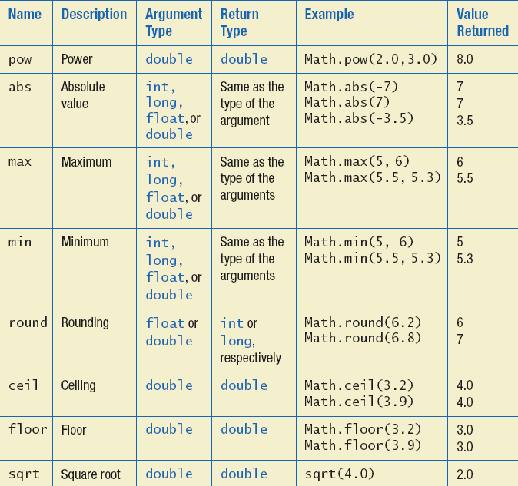
The Math Class
Example methods, figure 6.3b

Slide 33
Random Numbers
Math.random()returns a random double that is greater than or equal to zero and less than 1
Java also has a Random class to generate random numbers
Can scale using addition and multiplication; the following simulates rolling a six sided die
int die = (int) (6.0 * Math.random()) + 1;

Slide 34
Wrapper Classes
Recall that arguments of primitive type treated differently from those of a class type
May need to treat primitive value as an object
Java provides wrapper classes for each primitive type
Methods provided to act on values

Slide 35
Wrapper Classes
Allow programmer to have an object that corresponds to value of primitive type
Contain useful predefined constants and methods
Wrapper classes have no default constructor
Programmer must specify an initializing value when creating new object
Wrapper classes have no set methods

Slide 36
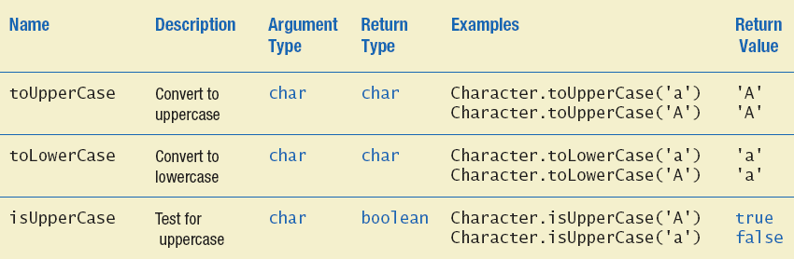
Wrapper Classes
Figure 6.4a Static methods in class Character

Slide 37
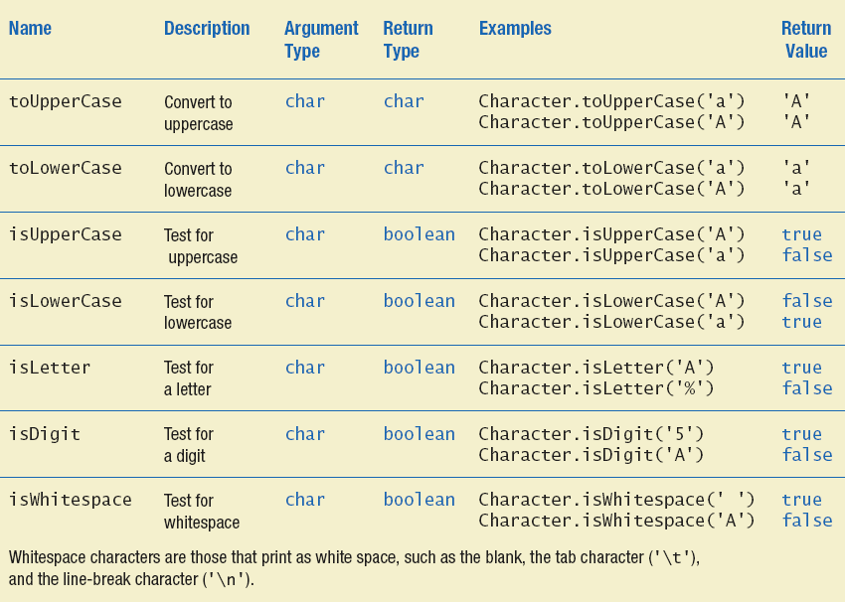
Wrapper Classes
Figure 6.4b Static methods in class Character

Slide 38
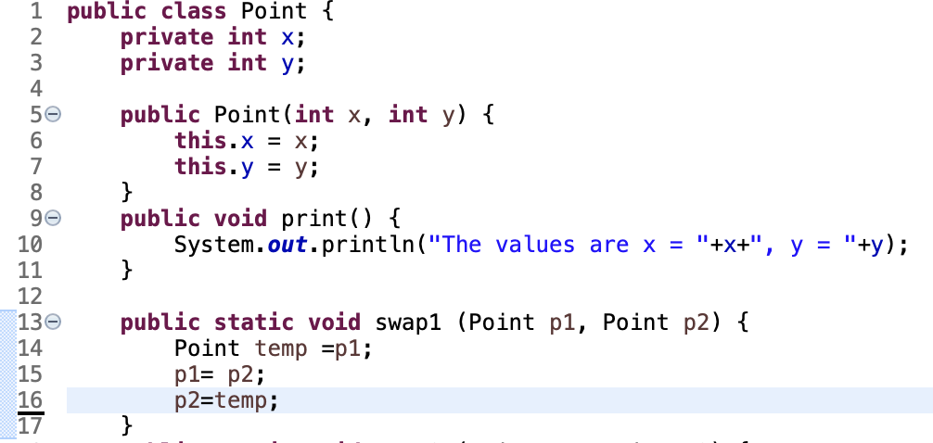
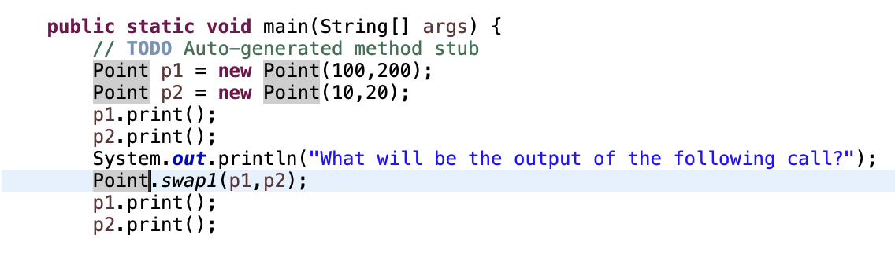
Passing Method Parameters

Slide 39
Passing Method Parameters
500
x=100
5735
P1=500
y=200

Slide 40
Passing Method Parameters
500
x=100
5735
P1=500
y=200
900
x=10
5775
P2=900
y=20

Slide 41
Passing Method Parameters
500
x=100
5735
P1=500
y=200
900
x=10
5775
P2=900
y=20
Screen Output

Slide 42
Passing Method Parameters
500
x=100
5735
P1=500
y=200
900
x=10
5775
P2=900
y=20
Screen Output
The values are x = 100, y = 200
The values are x = 10, y = 20

Slide 43
Passing Method Parameters
500
x=100
5735
P1=500
y=200
900
x=10
5775
P2=900
y=20
Screen Output
The values are x = 100, y = 200
The values are x = 10, y = 20

Slide 44
Passing Method Parameters
500
x=100
6735
P1=500
5735
P1=500
y=200
900
x=10
7775
P2=900
5775
P2=900
y=20
Screen Output
The values are x = 100, y = 200
The values are x = 10, y = 20

Slide 45
Passing Method Parameters
500
x=100
6735
P1=500
5735
P1=500
y=200
900
x=10
7775
P2=900
5775
P2=900
y=20
Screen Output
The values are x = 100, y = 200
The values are x = 10, y = 20
3750
temp

Slide 46
Passing Method Parameters
500
x=100
6735
P1=500
5735
P1=500
y=200
900
x=10
7775
P2=900
5775
P2=900
y=20
Screen Output
The values are x = 100, y = 200
The values are x = 10, y = 20
3750
temp=500

Slide 47
Passing Method Parameters
500
x=100
6735
P1=500
5735
P1=500
y=200
900
x=10
7775
P2=900
5775
P2=900
y=20
Screen Output
The values are x = 100, y = 200
The values are x = 10, y = 20
3750
temp=500

Slide 48
Passing Method Parameters
500
x=100
6735
P1=500 900
5735
P1=500
y=200
900
x=10
7775
P2=900
5775
P2=900
y=20
Screen Output
The values are x = 100, y = 200
The values are x = 10, y = 20
3750
temp=500

Slide 49
Passing Method Parameters
500
x=100
6735
P1=500 900
5735
P1=500
y=200
900
x=10
7775
P2=900
5775
P2=900
y=20
Screen Output
The values are x = 100, y = 200
The values are x = 10, y = 20
3750
temp=500

Slide 50
Passing Method Parameters
500
x=100
6735
P1=500 900
5735
P1=500
y=200
900
x=10
7775
P2=900 500
5775
P2=900
y=20
Screen Output
The values are x = 100, y = 200
The values are x = 10, y = 20
3750
temp=500

Slide 51
Passing Method Parameters
500
x=100
6735
P1=500 900
5735
P1=500
y=200
900
x=10
7775
P2=900 500
5775
P2=900
y=20
Screen Output
The values are x = 100, y = 200
The values are x = 10, y = 20
3750
temp=500

Slide 52
Passing Method Parameters
500
x=100
6735
P1=500 900
5735
P1=500
y=200
900
x=10
7775
P2=900 500
5775
P2=900
y=20
Screen Output
The values are x = 100, y = 200
The values are x = 10, y = 20
3750
temp=500

Slide 53
Passing Method Parameters
500
x=100
6735
P1=500 900
5735
P1=500
y=200
900
x=10
7775
P2=900 500
5775
P2=900
y=20
Screen Output
The values are x = 100, y = 200
The values are x = 10, y = 20
3750
The values are x = 100, y = 200
temp=500
The values are x = 10, y = 20

Slide 54
Case-2

Slide 55
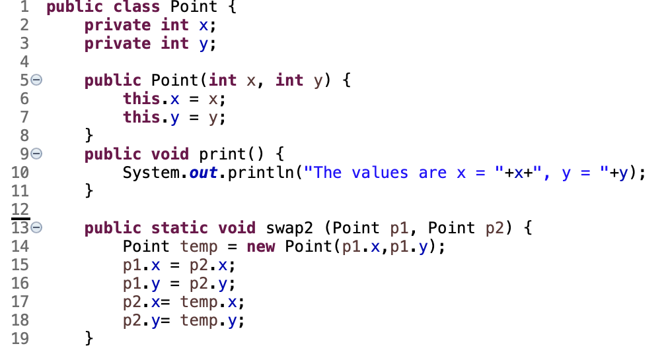
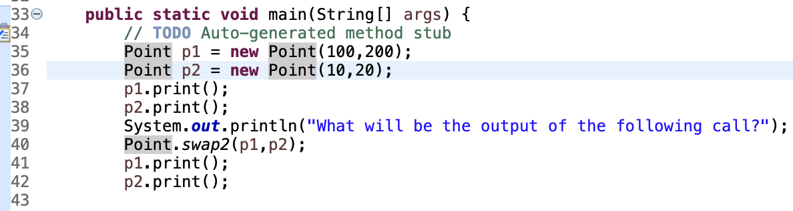
Passing Method Parameters
500
x=100
5735
P1=500
y=200

Slide 56
Passing Method Parameters
500
x=100
5735
P1=500
y=200
900
x=10
5775
P2=900
y=20

Slide 57
Passing Method Parameters
500
x=100
5735
P1=500
y=200
900
x=10
5775
P2=900
y=20
Screen Output

Slide 58
Passing Method Parameters
500
x=100
5735
P1=500
y=200
900
x=10
5775
P2=900
y=20
Screen Output
The values are x = 100, y = 200
The values are x = 10, y = 20

Slide 59
Passing Method Parameters
500
x=100
5735
P1=500
y=200
900
x=10
5775
P2=900
y=20
Screen Output
The values are x = 100, y = 200
The values are x = 10, y = 20

Slide 60
Passing Method Parameters
500
x=100
6735
P1=500
5735
P1=500
y=200
900
x=10
7775
P2=900
5775
P2=900
y=20
Screen Output
The values are x = 100, y = 200
The values are x = 10, y = 20

Slide 61
Passing Method Parameters
500
x=100
6735
P1=500
5735
P1=500
y=200
900
x=10
7775
P2=900
5775
P2=900
y=20
Screen Output
The values are x = 100, y = 200
The values are x = 10, y = 20
3750
temp

Slide 62
Passing Method Parameters
500
x=100
6735
P1=500
5735
P1=500
y=200
900
x=10
7775
P2=900
5775
P2=900
y=20
Screen Output
The values are x = 100, y = 200
The values are x = 10, y = 20
3750
temp
100
x=100
y=200

Slide 63
Passing Method Parameters
500
x=100
6735
P1=500
5735
P1=500
y=200
900
x=10
7775
P2=900
5775
P2=900
y=20
Screen Output
The values are x = 100, y = 200
The values are x = 10, y = 20
3750
temp = 100
100
x=100
y=200

Slide 64
Passing Method Parameters
500
x=100
6735
P1=500
5735
P1=500
y=200
900
x=10
7775
P2=900
5775
P2=900
y=20
Screen Output
The values are x = 100, y = 200
The values are x = 10, y = 20
3750
temp = 100
100
x=100
y=200

Slide 65
Passing Method Parameters
500
x=100 10
6735
P1=500
5735
P1=500
y=200 20
900
x=10
7775
P2=900
5775
P2=900
y=20
Screen Output
The values are x = 100, y = 200
The values are x = 10, y = 20
3750
temp = 100
100
x=100
y=200

Slide 66
Passing Method Parameters
500
x=100 10
6735
P1=500
5735
P1=500
y=200 20
900
x=10
7775
P2=900
5775
P2=900
y=20
Screen Output
The values are x = 100, y = 200
The values are x = 10, y = 20
3750
temp = 100
100
x=100
y=200

Slide 67
Passing Method Parameters
500
x=100 10
6735
P1=500
5735
P1=500
y=200 20
900
x=10 100
7775
P2=900
5775
P2=900
y=20 200
Screen Output
The values are x = 100, y = 200
The values are x = 10, y = 20
3750
temp = 100
100
x=100
y=200

Slide 68
Passing Method Parameters
500
x=100 10
6735
P1=500
5735
P1=500
y=200 20
900
x=10 100
7775
P2=900
5775
P2=900
y=20 200
Screen Output
The values are x = 100, y = 200
The values are x = 10, y = 20
3750
temp = 100
100
x=100
y=200

Slide 69
Passing Method Parameters
500
x=100 10
6735
P1=500
5735
P1=500
y=200 20
900
x=10 100
7775
P2=900
5775
P2=900
y=20 200
Screen Output
The values are x = 100, y = 200
The values are x = 10, y = 20
3750
The values are x = 10, y = 20
temp = 100
The values are x = 100, y = 200
100
x=100
y=200

Slide 70
Case-3

Slide 71
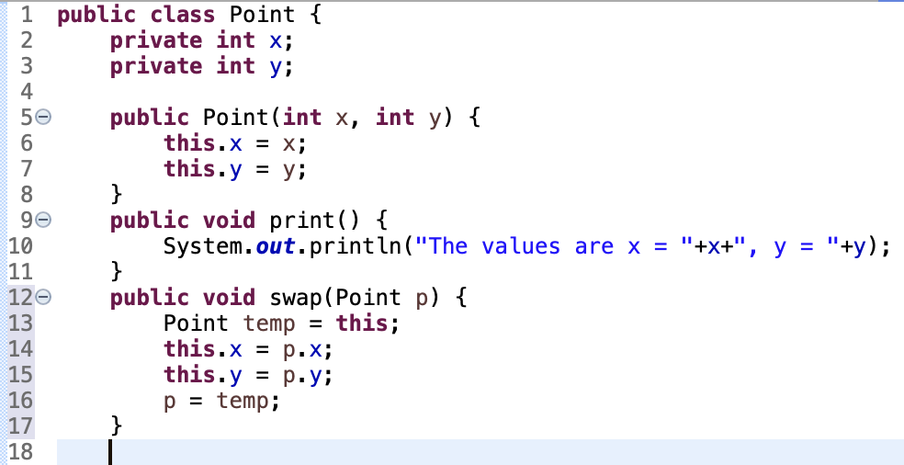
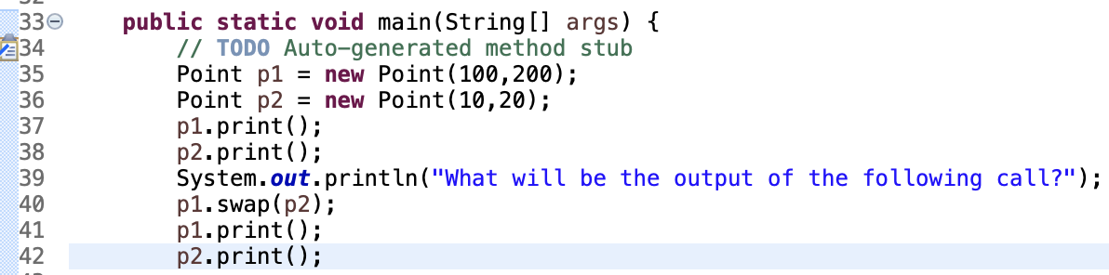
Case-3 Passing Method Parameters

Slide 72
Passing Method Parameters
500
x=100
5735
P1=500
y=200

Slide 73
Passing Method Parameters
500
x=100
5735
P1=500
y=200
900
x=10
5775
P2=900
y=20

Slide 74
Passing Method Parameters
500
x=100
5735
P1=500
y=200
900
x=10
5775
P2=900
y=20
Screen Output

Slide 75
Passing Method Parameters
500
x=100
5735
P1=500
y=200
900
x=10
5775
P2=900
y=20
Screen Output

Slide 76
Passing Method Parameters
500
x=100
5735
P1=500
y=200
900
x=10
5775
P2=900
y=20
Screen Output
The values are x = 100, y = 200
The values are x = 10, y = 20

Slide 77
Passing Method Parameters
500
x=100
5735
P1=500
y=200
900
x=10
5775
P2=900
y=20
Screen Output
The values are x = 100, y = 200
The values are x = 10, y = 20

Slide 78
Passing Method Parameters
500
x=100
5735
P1=500
y=200
6735
P=?
900
x=10
5775
P2=900
y=20
Screen Output
The values are x = 100, y = 200
The values are x = 10, y = 20

Slide 79
Passing Method Parameters
500
x=100
5735
P1=500
y=200
6735
P=900
900
x=10
5775
P2=900
y=20
Screen Output
The values are x = 100, y = 200
The values are x = 10, y = 20

Slide 80
Passing Method Parameters
500
x=100
5735
P1=500
y=200
6735
P=900
900
x=10
5775
P2=900
y=20
Screen Output
The values are x = 100, y = 200
The values are x = 10, y = 20

Slide 81
Passing Method Parameters
500
x=100
5735
P1=500
y=200
6735
P=900
900
x=10
5775
P2=900
y=20
3750
temp
Screen Output
The values are x = 100, y = 200
The values are x = 10, y = 20

Slide 82
Passing Method Parameters
500
x=100
5735
P1=500
y=200
6735
P=900
900
x=10
5775
P2=900
y=20
3750
temp=?
Screen Output
The values are x = 100, y = 200
The values are x = 10, y = 20

Slide 83
Passing Method Parameters
500
x=100
5735
P1=500
y=200
6735
P=900
900
x=10
5775
P2=900
y=20
3750
temp=500
Screen Output
The values are x = 100, y = 200
The values are x = 10, y = 20

Slide 84
Passing Method Parameters
500
x=100
5735
P1=500
y=200
6735
P=900
900
x=10
5775
P2=900
y=20
3750
temp=500
Screen Output
The values are x = 100, y = 200
The values are x = 10, y = 20

Slide 85
Passing Method Parameters
500
x=100 10
5735
P1=500
y=200 20
6735
P=900
900
x=10
5775
P2=900
y=20
3750
temp=500
Screen Output
The values are x = 100, y = 200
The values are x = 10, y = 20

Slide 86
Passing Method Parameters
500
x=100 10
5735
P1=500
y=200 20
6735
P=900
900
x=10
5775
P2=900
y=20
3750
temp=500
Screen Output
The values are x = 100, y = 200
The values are x = 10, y = 20

Slide 87
Passing Method Parameters
500
x=100 10
5735
P1=500
y=200 20
6735
P=900 3750
900
x=10
5775
P2=900
y=20
3750
temp=500
Screen Output
The values are x = 100, y = 200
The values are x = 10, y = 20

Slide 88
Passing Method Parameters
500
x=100 10
5735
P1=500
y=200 20
6735
P=900 3750
900
x=10
5775
P2=900
y=20
3750
temp=500
Screen Output
The values are x = 100, y = 200
The values are x = 10, y = 20

Slide 89
Passing Method Parameters
500
x=100 10
5735
P1=500
y=200 20
6735
P=900 3750
900
x=10
5775
P2=900
y=20
3750
temp=500
Screen Output
The values are x = 100, y = 200
The values are x = 10, y = 20
The values are x = ?, y = ?
The values are x = ?, y = ?

Slide 90
Passing Method Parameters
500
x=100 10
5735
P1=500
y=200 20
6735
P=900 3750
900
x=10
5775
P2=900
y=20
3750
temp=500
Screen Output
The values are x = 100, y = 200
The values are x = 10, y = 20
The values are x = 10, y = 20
The values are x = 10, y = 20

Slide 91
Writing Methods: Outline
Case Study: Formatting Output
Decomposition
Addressing Compiler Concerns
Testing Methods

Slide 92
Formatting Output
Algorithm to display a double amount as dollars and cents
1. dollars = the number of whole dollars in amount.
2. cents = the number of cents in amount. Round if there are more than two digits after the decimal point.
3. Display a dollar sign, dollars, and a decimal point.
4. Display cents as a two-digit integer.

Slide 93
Formatting Output
View sample code, listing 6.12 class DollarFormatFirstTry
Note code to separate dollars and cents
Note if-else statement
View sample program, listing 6.13 class DollarFormatFirstTryDriver
Note call to the write method

Slide 94
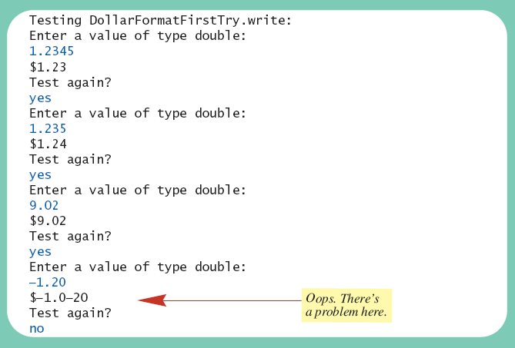
Formatting Output
Sample screen output

Slide 95
Formatting Output
View corrected code, listing 6.14 class DollarFormat
Note code to handle negative values
Program in listing 6.13 will now print values correctly

Slide 96
Decomposition
Recall pseudocode from previous slide
With this pseudocode we decompose the task into subtasks
Then solve each subtask
Combine code of subtasks
Place in a method

Slide 97
Addressing Compiler Concerns
Compiler ensures necessary tasks are done
Initialize variables
Include return statement
Rule of thumb: believe the compiler
Change the code as requested by compiler
It is most likely correct

Slide 98
Testing Methods
To test a method use a driver program
Example – code in listing 6.13
Every method in a class should be tested
Bottom-up testing
Test code at end of sequence of method calls first
Use a stub – simplified version of a method for testing purposes

Slide 99
Overloading: Outline
Overloading Basics
Overloading and Automatic Type Conversion
Overloading and the Return Type
Programming Example: A Class for Money

Slide 100
Overloading Basics
When two or more methods have same name within the same class
Java distinguishes the methods by number and types of parameters
If it cannot match a call with a definition, it attempts to do type conversions
A method's name and number and type of parameters is called the signature

Slide 101

Overloading Basics
View example program, listing 6.15 class Overload
Note overloaded method getAverage
Sample screen output

Slide 102
Overloading and Type Conversion
Overloading and automatic type conversion can conflict
Recall definition of Pet class of listing 6.1
If we pass an integer to the constructor we get the constructor for age, even if we intended the constructor for weight
Remember the compiler attempts to overload before it does type conversion
Use descriptive method names, avoid overloading

Slide 103
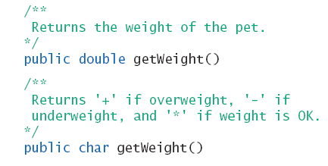
Overloading and Return Type
You must not overload a method where the only difference is the type of value returned

Slide 104
Programming Example
A class for money
View sample class, listing 6.16 class Money
Note use of
Private instance variables
Methods to set values
Methods for doing arithmetic operations

Slide 105
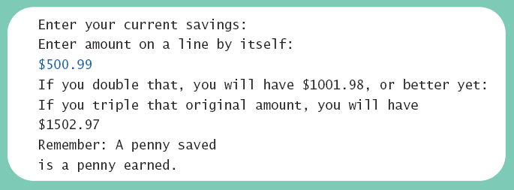
Programming Example
View demo program, listing 6.17 class MoneyDemo
Sample screen output

Slide 106
Information Hiding Revisited
Privacy Leaks
Instance variable of a class type contain address where that object is stored
Assignment of class variables results in two variables pointing to same object
Use of method to change either variable, changes the actual object itself
View insecure class, listing 6.18 class petPair

Slide 107
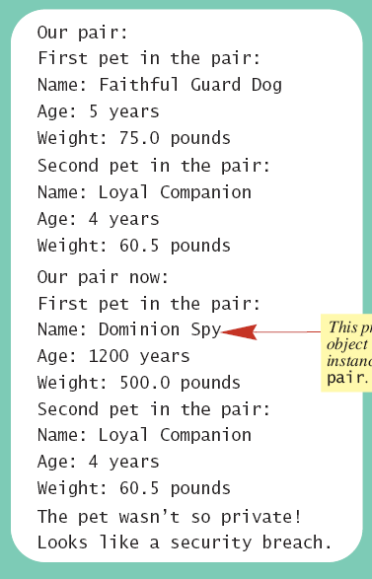

Information Hiding Revisited
View sample program, listing 6.19 class Hacker
Sample screen output

Slide 108
Enumeration as a Class
Consider defining an enumeration for suits of cards enum Suit {CLUBS, DIAMONDS, HEARTS, SPADES}
Compiler creates a class with methods
equals
compareTo
ordinal
toString
valueOf

Slide 109
Enumeration as a Class
View enhanced enumeration, listing 6.20 enum Suit
Note
Instance variables
Additional methods
Constructor

Slide 110
Packages: Outline
Packages and Importing
Package Names and Directories
Name Clashes

Slide 111
Packages and Importing
A package is a collection of classes grouped together into a folder
Name of folder is name of package
Each class
Placed in a separate file
Has this line at the beginning of the file package Package_Name;
Classes use packages by use of import statement

Slide 112
Package Names and Directories
Package name tells compiler path name for directory containing classes of package
Search for package begins in class path base directory
Package name uses dots in place of / or \
Name of package uses relative path name starting from any directory in class path

Slide 113
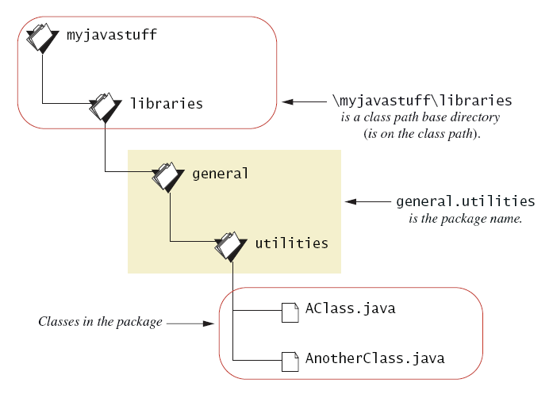
Package Names and Directories
Figure 6.5 A package name

Slide 114
Name Clashes
Packages help in dealing with name clashes
When two classes have same name
Different programmers may give same name to two classes
Ambiguity resolved by using the package name

Slide 115
Graphics Supplement: Outline
Adding buttons
Adding button images

Slide 116
Adding Buttons
Create object of type Button
Then add to the scene
Buttons don’t do anything yet when clicked, this is covered in the chapter 8

Slide 117
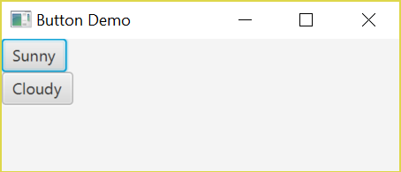
Adding Buttons
Application Output
If the user clicks either of these buttons, nothing happens.

Slide 118
Adding Images
An image is a picture
Can load an image stored in standard formats by creating an Image object and sending in the pathname to the file
Image img = new Image(“pathname-to-image-file“);
Image can be added to other components, such as a button
btn.setGraphic(new ImageView(img));

Slide 119
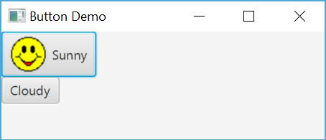
Button Image Demo
View button image demo, listing 6.22 class IconDemo
Note
Creation of image
Attaching image to button
Sample screen output

Slide 120
Summary
Constructor method creates, initializes object of a class
Default constructor has no parameters
Within a constructor use this as name for another constructor in same class
A static variable shared by all objects of the class

Slide 121
Summary
Primitive type has wrapper class to allow treatment as an object
Java performs automatic type cast between primitive type and object of wrapper class as needed
Divide method tasks into subtasks
Test all methods individually

Slide 122
Summary
Methods with same name, different signatures are overloaded methods
An enumeration is a class – can have instance variables, constructors, methods
A package of class definitions grouped together in same folder, contain a package statement at beginning of each class

